Slide 1
Lesson 4
CAN Advance Topic
Notes:
1) Xin chao moi nguoi, cam on moi nguoi da tham gia vao khoa hoc FuSa
Buoi hom nay la ve phan session 1, overview ve FuSa
2) Truoc em cung gui tai lieu ve FuSa, anh chi em thay the nao. Tai lieu co de hieu khong ah, cam giac FuSa co de khong ah.
3) Em xin phep buoi nay nhu chia se kien thuc, kinh Nghiem ve FuSa.
Cac anh chi em da co kinh Nghiem lau nam, nen neu co gi khiem khuyet xin cac anh chi em dai xa cho

Slide 2
Contents
CAN error
Definition
Error Frame Format
CAN error states
CAN FD

Slide 3
CAN FD - topic
Overview about CAN-FD (What/Why)
Explain the CAN FD format
Compare with Classic CAN.

Slide 4



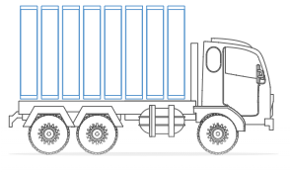
CAN FD - ① Overview about CAN-FD (What/Why)
What is CAN FD?
◇ CAN FD(Controller Area Network with Flexible Data Rate)
◇ CAN FD – an improved communication protocol of CAN 2.0
◇ The CAN FD protocol was pre-developed by Bosch (with industry experts) and released in 2012.
◇ CAN FD’s benefits:
#1 Increased length
#2 Increased speed
➡CAN FD supports a flexible message payload,
ranging from 0, 8, 12, 16, 20, 24, 32, 48, 64 bytes (CAN: Max: 8byte) per frame
at 2, 5 and 8 Mbps (CAN: Max 1 Mbit/s) of data rates.

Slide 5
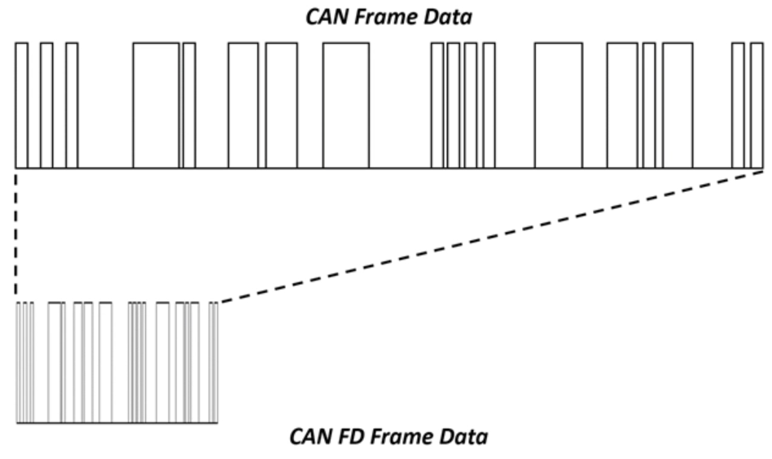
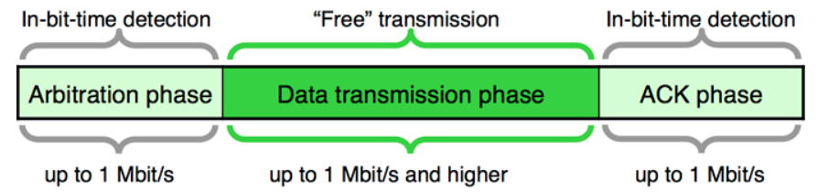
CAN FD - ① Overview about CAN-FD (What/Why)
What is CAN FD?
Also, the CAN FD Protocol has two independent bit rates for the arbitration and data phases.
（The arbitration phase uses the same bit timing as the Classical CAN, but the data bit rate is either similar or higher than the arbitration bit rate.）
A faster bit-rate for CAN FD payloads allows for more data to fit into a single message.

Slide 6

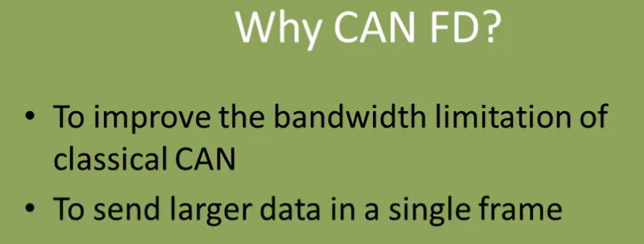
CAN FD - ① Overview about CAN-FD (What/Why)
Why is CAN FD?
Outside of CAN, there are other in-vehicle networks that have higher communication bandwidths than 1 Mbit/s. However, these networks, like FlexRay and automotive Ethernet, are significantly different from the CAN physical layer, which means that making a change to support them instead of CAN is very expensive for the suppliers and OEMs.
CAN FD is also ideal for this problem because the physical layer is the same as high-speed CAN. The only difference in the hardware is to use a new protocol controller with a qualified transceiver that allows the faster speeds. Also, the software changes are minimal since the message format is very similar. In fact, there are no software changes needed when using CAN FD messages at speeds up to 1 Mbit/s and 8 byte payloads.

Slide 7
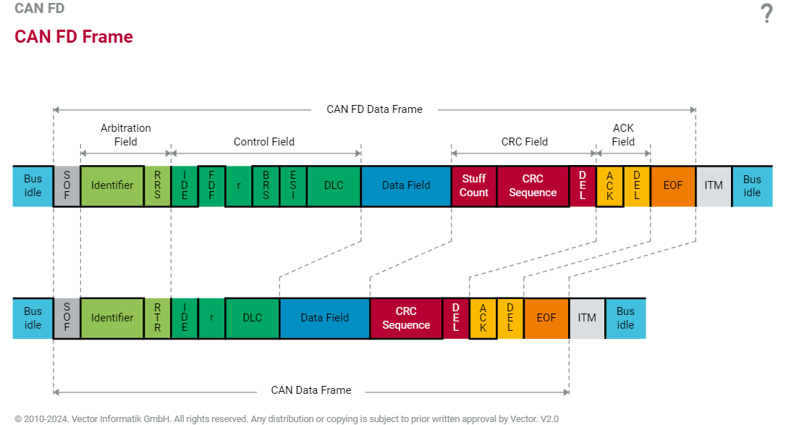
CAN FD - ② Explain the CAN FD format

Slide 8
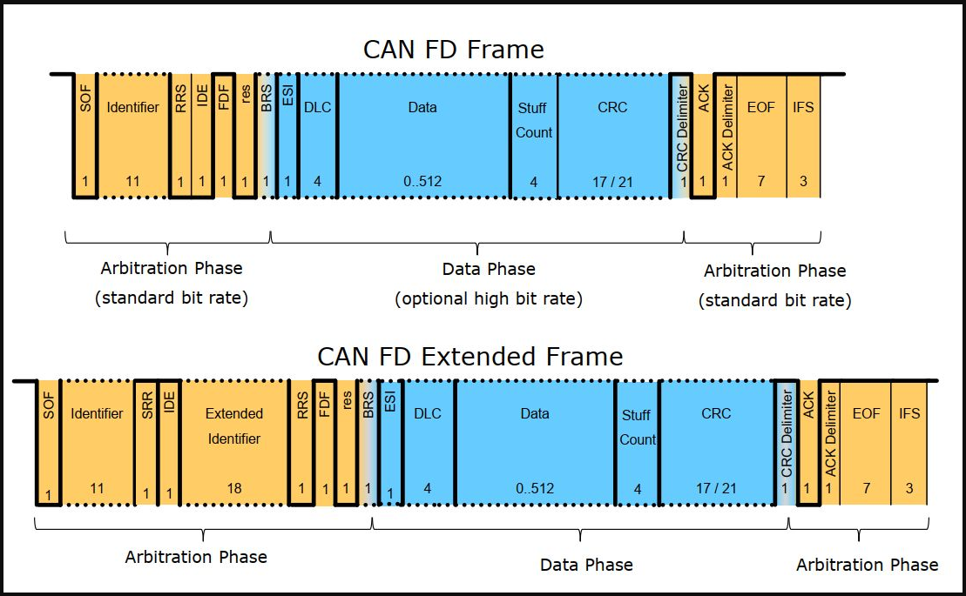
CAN FD - ② Explain the CAN FD format

Slide 9
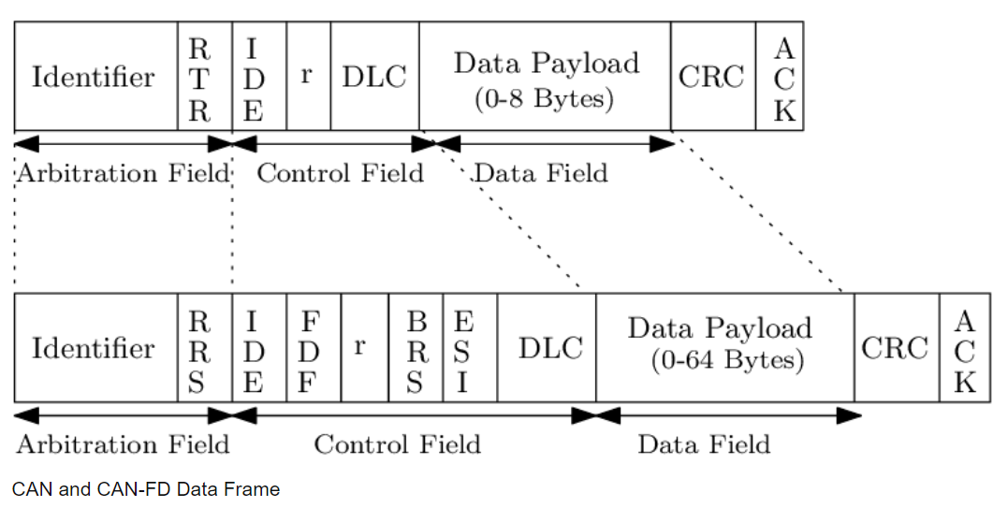
CAN FD - ② Explain the CAN FD format
RRS – Remote Request Substitution (The RTR bit in CAN frames becomes RRS (Remote Request Substitution) - always dominant since in CAN-FD there are no remote frames)
IDE, r – same as in the standard CAN frame format
FDF – FD Format Indicator (The reserve bit of the traditional CAN frame now becomes the switch for the CAN FD format. If transferred dominant as 0, it denotes a classical CAN frame. If it contains the recessive value 1, it denotes a CAN FD frame.)
https://elearning.vector.com/mod/page/view.php?id=363

Slide 10
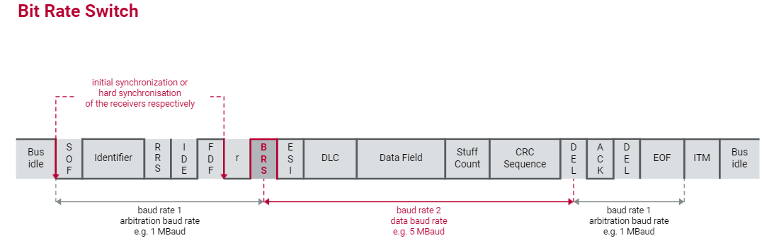
CAN FD - ② Explain the CAN FD format
BRS – Bit Rate Switch (If this bit is dominant, then the bit rate in the CAFD frame remains the same throughout the frame. When this bit is set to recessive, the bit rate of the data field and CRC field is switched from a standard bit rate to preconfigured bit rate.)
ESI – Error State Indicator (It is dominant, if the ECU is in the Error Active state. If it is recessive it indicates that the ECU is in the state Error Passive. The purpose of this bit is to enable a more transparent way of tracking errors, as well as a simpler network management. The states Error Active and Error Passive of the network nodes are communicated on the entire network.)
https://elearning.vector.com/mod/page/view.php?id=363

Slide 11
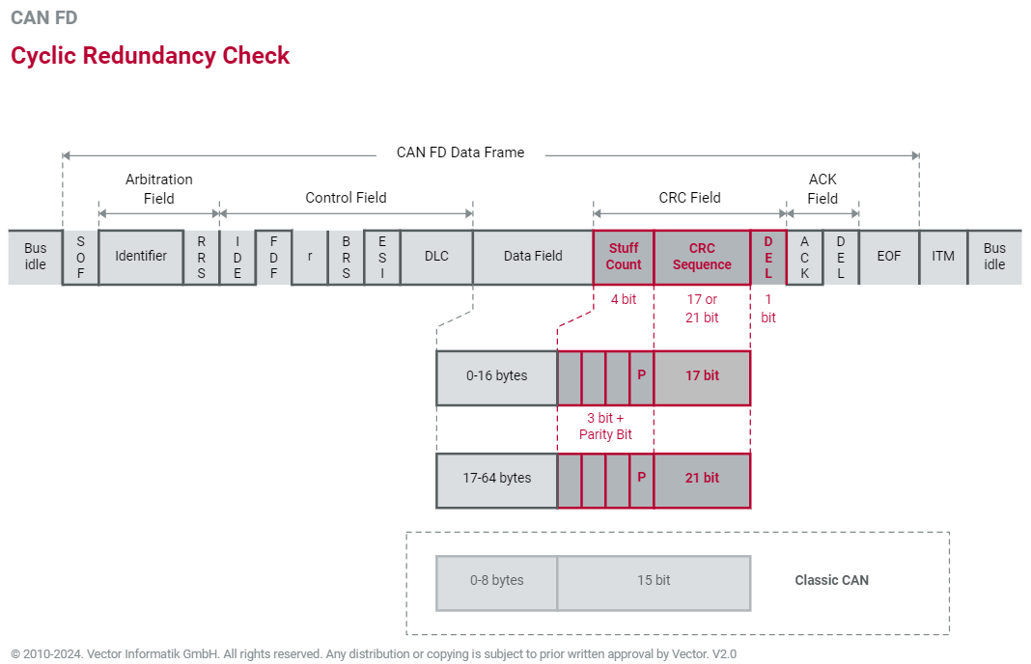
CAN FD - ② Explain the CAN FD format
CRC Field: Stuff Count
More data = longer CRC
The probability of bit errors in a CAN FD frame increases compared to traditional CAN.
This is the case because of the shorter bit times of Baudrate 2 on one hand and the much greater number of bits in the data field.
• Stuff count field added to CAN-FD frames to solve the CRC fail issue.

Slide 12
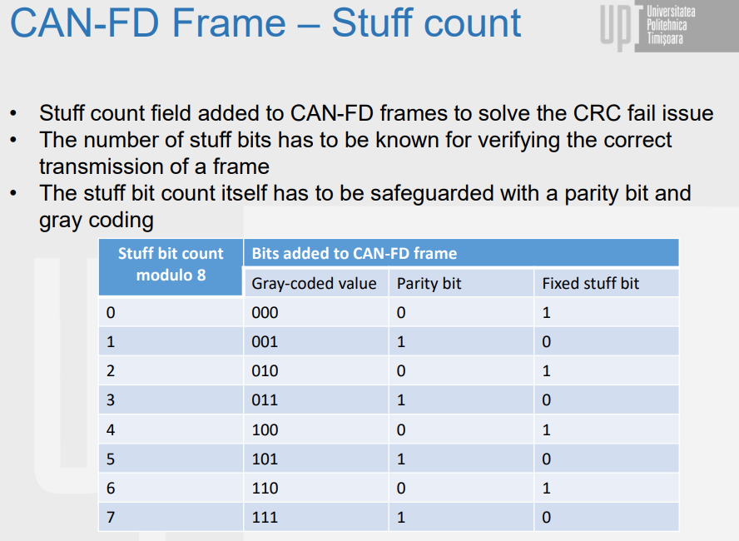
CAN FD - ② Explain the CAN FD format
CAN with Flexible Data-Rate – CAN-FD (upt.ro)

Slide 13
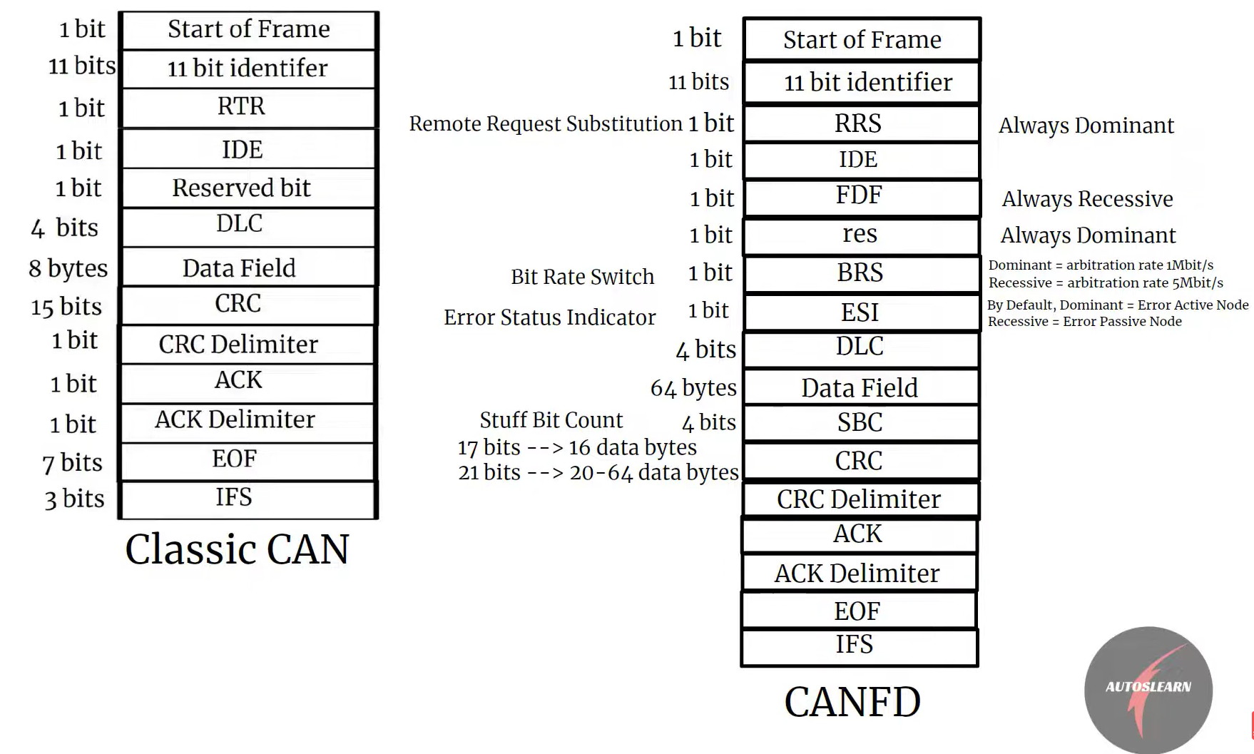
CAN FD - ② Explain the CAN FD format
Vector PowerPoint Template V4.0

Slide 14
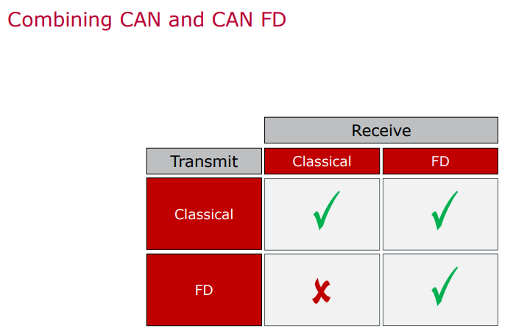
CAN FD - ③ Compare with Classic CAN

Slide 15
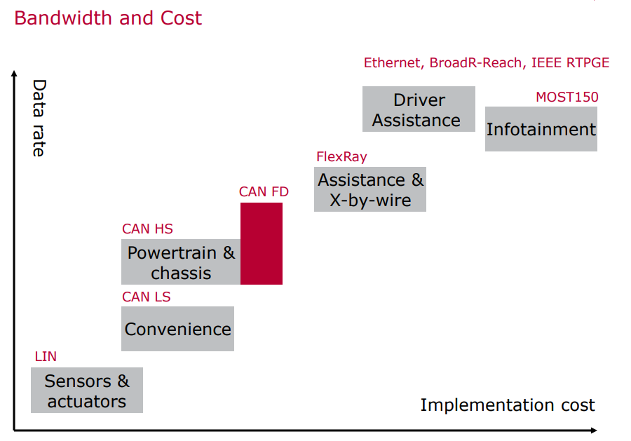
CAN FD - ③ Compare with Classic CAN

Slide 16
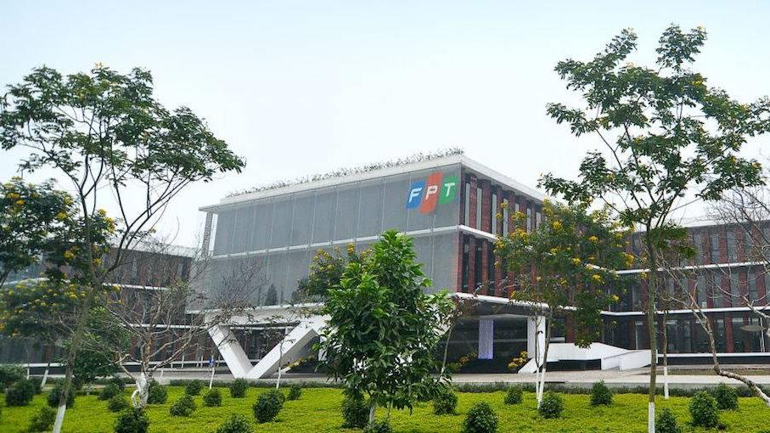


THANK YOU

